Slide 1

Components, modules, and services

Slide 2
Components in Angular
Components are the fundamental building blocks of Angular applications
They encapsulate a specific part of the user interface (UI) and its associated behavior. Each component acts as a self-contained unit, managing its own logic and presentation.

Slide 3
Benefits of components
01
Modularity
Components enable a modular structure, making it easier to understand, maintain, and extend the application.
02
Reusability
Components can be reused across different parts of the application, promoting code reuse and minimizing duplication.
03
Isolation
Each component is encapsulated, reducing the risk of unintended interactions with other parts of the application.

Slide 4
Create a Component
Use below command to generate the component in necessary files and folders.
ng generate component <component_name>
OR
ng g c <component_name>

Slide 5

Basic Example on Angular component
Step 1: Create a component by using below command
ng g c first_task
In this command we created first_task as a component once this command get execute below files will get generated in your project folder.

Slide 6
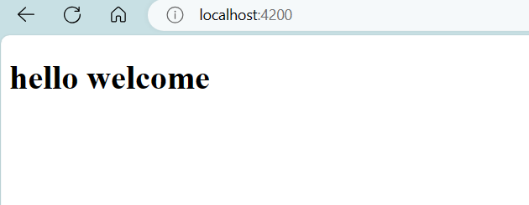
Step 2: Update \src\app\app.component.html file
Once you make changes execute ng serve command on terminal to get find changes on localhost server
<h1> hello welcome</h1>

Slide 7
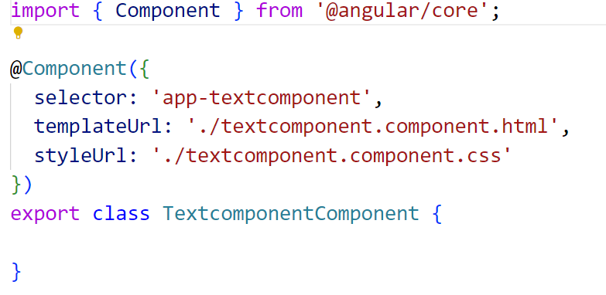
Step 3: Update\src\app\first-task\first_task.component.html file
<h3>Angular Component Example</h3>
Go to your \src\app\first-task\first_task.component.ts file and copy selector data
Copy ‘app-textcomponent’

Slide 8
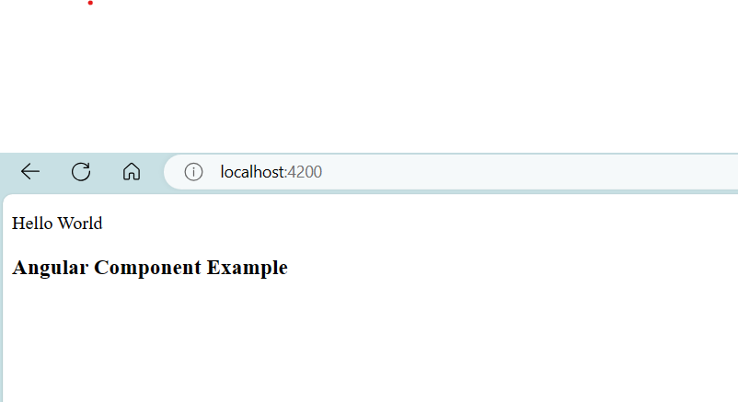
Step 4: go back to \src\app\app.component.html file and update custom tag in the same file.
After updating this file we can see first_task.component.html file data on localhost
<p>Hello World</p>
<app-textcomponent></app-textcomponent>

Slide 9
Using component in Angular
Go to component.html and component.css files and write the necessary code in both of the files.
Write corresponding code is component.ts extension file.
Run the Angular app using ng serve –open

Slide 10
Remember
What is the purpose of the @Component decorator in Angular?
A. It defines the component's template.
B. It provides dependency injection for the component.
C. It configures the component metadata.
D. It handles component events.
C

Slide 11
Apply
What is the purpose of the *ngFor directive in an Angular component template?
A. It creates a conditional statement.
B. It provides two-way data binding.
C. It iterates over a list of items.
D. It defines a custom event.
C

Slide 12
Angular Modules
Modules in Angular are organizational units that group related components, directives, pipes, and services.
They encapsulate and organize code, promoting modularity and maintainability.

Slide 13
Why do we need Modules in Angular?
Organization
Modules help organize and structure an Angular application.
Reusability
Modules facilitate code reuse by encapsulating related functionality.
Maintainability
Modules make it easier to manage and maintain large codebases.

Slide 14
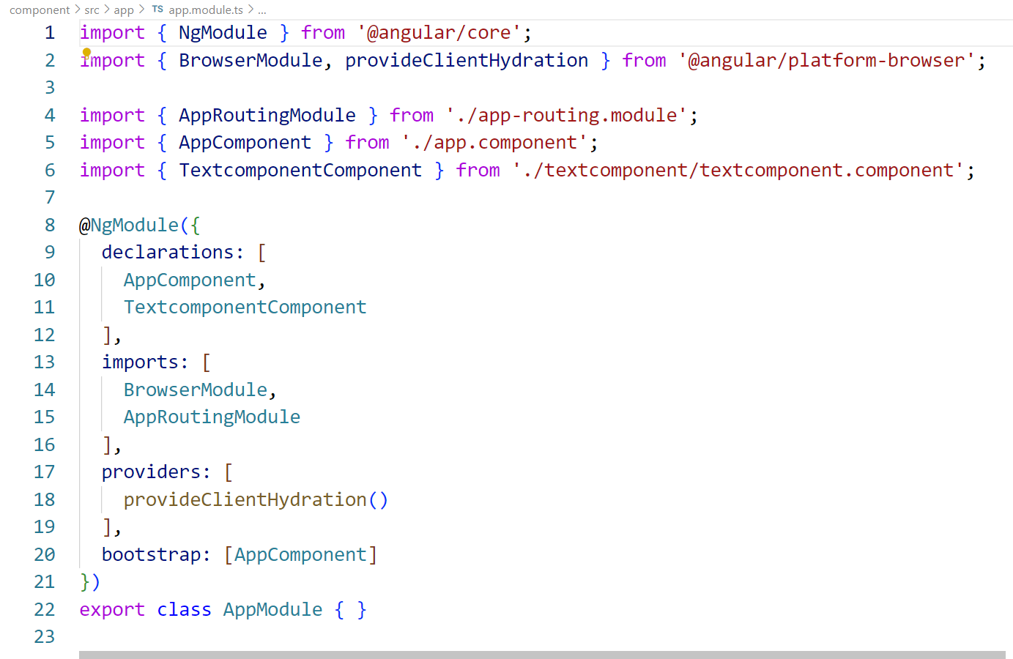
Creating Angular Modules
To create module we can use ‘@NgModule’ Decorator.
When we create a new project using the Angular –cli command, the ngmodule is created in the app.module.ts file by default
App.module.ts file

Slide 15
Key Properties of an Angular Module
Declaration
The declarations array includes the components, directives, and pipes that belong to the module.
These are the building blocks that are scoped to the module.
declarations: [
AppComponent,
NewCmpComponent
]

Slide 16
Key Properties of an Angular Module
Imports
The imports array lists other modules that this module depends on.
Importing modules allows the components of the current module to use components from other modules.
import { FormsModule } from '@angular/forms'; // if your application need form you can include like this.
import in the @NgModule will be like the following −
imports: [
BrowserModule,
FormsModule
]

Slide 17
Key Properties of an Angular Module
Providers
The providers array contains services that the module contributes to the dependency injection system.
These services are available for injection in the components of the module.
The bootstrap array specifies the component that should be bootstrapped when the module is loaded.
This is typically the root component of the application.
Bootstrap

Slide 18
Understand
What does the 'declarations' property in an NgModule decorator include?
A. Services
B. Components, directives, and pipes
C. External modules
D. Bootstrap components
B

Slide 19
Apply
In an Angular module, what does the 'bootstrap' property specify?
A. The main application module
B. The root component to be bootstrapped
C. The lazy-loaded modules
D. External modules
B

Slide 20
Angular Services
Services are a way to organize and share code across components.
They provide a centralized place for features, data, and logic that are independent of components.

Slide 21
Why do we need Services in Angular?
Encourages code reuse and maintainability.
Facilitates separation of concerns.
Supports a modular and scalable application architecture.

Slide 22
Creating Angular Services
Use the Angular CLI to generate a service . follow bellow syntax to create services
ng generate service service_name
This will create two files:
src/app/service_name.service.ts: The TypeScript file for your service.
src/app/service_name.service.spec.ts: The unit test file for your service.

Slide 23
Implement the Service
To Implement angular services we need to composed three things:
1) create an export class
2) decorate the class with @Injectable decorator
3) import the injectable decorator from the @angular/core library
Syntax to Implement angular services
import { Injectable } from '@angular/core';
@Injectable({
providedIn: 'root', // or specify a module
})
export class MyService {
// Service logic goes here
}

Slide 24
Implement the Service
import { Injectable } from '@angular/core';
@Injectable({
providedIn: 'root'
})
export class DataService {
private data: string[] = ['Item 1', 'Item 2', 'Item 3'];
getData(): string[] {
return this.data;
}
addData(newItem: string): void {
this.data.push(newItem);
}
}
Open the generated service file (service_name.service.ts) using your preferred code editor. You'll find a basic service structure with an @Injectable decorator. Add your service logic inside the class
Example

Slide 25
Use the Service in a Component
Open a component file (e.g., src/app/app.component.ts) and import the service. Inject the service into the component's constructor
import { Component } from '@angular/core';
import { DataService } from './data.service';
@Component({
selector: 'app-root',
templateUrl: './app.component.html',
styleUrls: ['./app.component.css']
})
export class AppComponent {
items: string[];
constructor(private dataService: DataService) {
this.items = this.dataService.getData();
}
addItem(newItem: string): void {
this.dataService.addData(newItem);
this.items = this.dataService.getData(); // Update the displayed items
}
}

Slide 26
Update the Component's Template
Open the component's template file (e.g., src/app/app.component.html) and use the service data
<div *ngFor="let item of items">
{{ item }}
</div>
<input #newItemInput placeholder="New Item">
<button (click)="addItem(newItemInput.value)">Add Item</button>

Slide 27
Run The Application
Use below command to run application
ng serve
Visit http://localhost:4200 in your browser to see your Angular app with the newly created service in action.

Slide 28
Apply
In which file type are Angular services typically defined?
A) .html
B) .ts
C) .css
D) .json
B

Slide 29
Craete
Demonstrate how to create an Angular service using the Angular CLI.
A) ng new service MyService
B) ng create service MyService
C) ng generate service MyService
D) ng build service MyService
C

Slide 30


Slide 31
Thank You

